Slide 1


ME 322: Machine Design
Basic Lubrication Theory
Prof. S. K. Kakoty

Slide 2
Tribology
Tribology is the Science of Friction, Wear and Lubrication
The word is coined from a Greek word “Tribos” meaning Rubbing Surfaces.
Frictional heating, Material loss due to Wear, Failure due to Fatigue need to be considered in machine design. Lubrication results in slowing down wear and reduction of friction significantly. Therefore, lubrication is a means to increase the life of machine parts.

Slide 3
Lubrication
Lubrication is the science of reducing friction by application of a suitable substance called lubricant, between the rubbing surfaces of bodies having relative motion.
The liquid lubricant also carries some amount of heat and cools the system.

Slide 4
The lubricants are classified into three groups:
Liquid lubricants like mineral oils, animal fats and vegetable oils
Semi-solid lubricants like Grease and Vaseline
Solid lubricants like wax, talc, graphite and molybdenum disulphide: Many new materials like different types of composites.

Slide 5
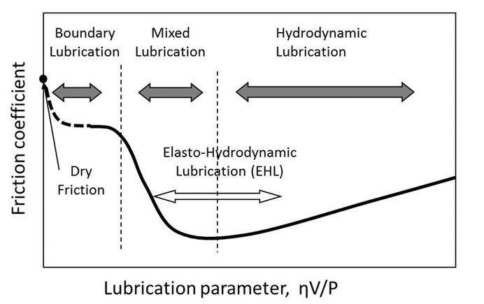
Lubrication Regimes:
Boundary Lubrication
Mixed Lubrication
Hydrodynamic Lubrication
Elastohydrodynamic Lubrication is observed in an intermediate range of mixed and hydrodynamic lubrication.
Fig. 1: Stribeck Curve

Slide 6
Basic Modes of Lubrication
Hydrodynamic Lubrication
Hydrostatic Lubrication
Elastohydrodynamic Lubrication
Mixed Lubrication
Boundary Lubrication

Slide 7
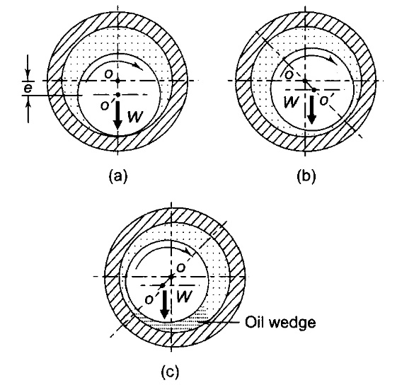
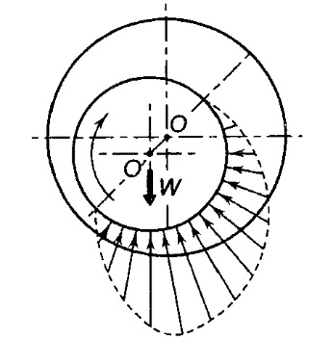
Hydrodynamic lubrication
Principle of hydrodynamic lubrication in journal bearings
Fig 3: Pressure Distribution
Fig 2: Mechanism of pressure development
Journal at rest (b) Journal starts to rotate (c) Journal at full speed

Slide 8
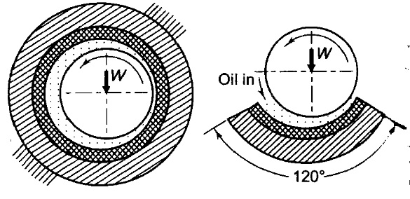
Hydrodynamic journal bearings
There are two types of Hydrodynamic journal bearings
Full journal bearing
Partial bearing
Fig 4: (a) full bearing (b) Partial bearing

Slide 9
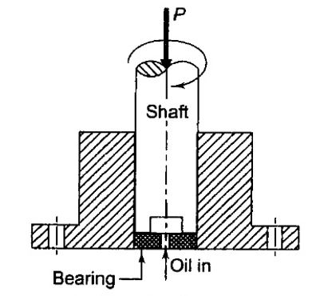
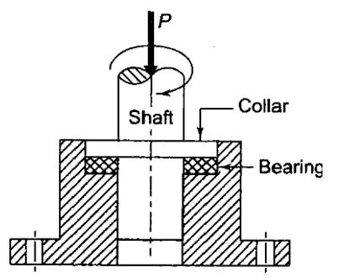
Thrust bearings
There are two types of thrust bearings which takes axial load.
Foot step bearing
Collar bearing
Fig 5: (a) Footstep bearing (b) Collar bearing

Slide 10
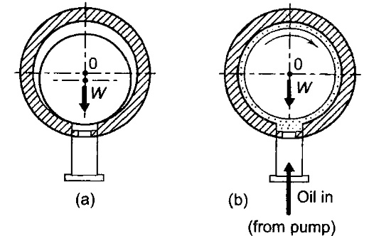
Hydrostatic Lubrication
Hydrostatic lubrication is defined as a system of lubrication in which the load supporting fluid film, separating the two surfaces is maintained by an external source, like a pump, supplying sufficient fluid under pressure.
Fig 6: Principle of Hydrostatic lubrication
(a) Journal at rest (b) Journal at full speed

Slide 11
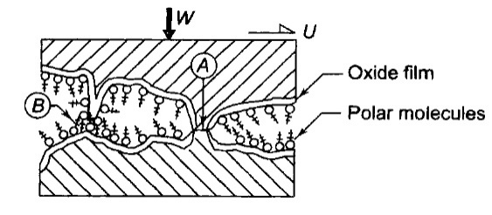
Boundary lubrication
Boundary or thin film lubrication is defined as a condition of lubrication where the lubricant film is relatively thin and there is partial metal to metal contact.
Fig 7: Boundary Lubrication (a) Metal to metal contact (b) Cluster of molecules

Slide 12
Elastohydrodynamic Lubrication
When the fluid film pressure is high and the surfaces to be separated are not sufficiently rigid, there is elastic deformation of the contacting surfaces.
This elastic deflection is useful in the formation of the fluid film in certain cases.
Since the hydrodynamic film is developed due to elastic deflection of the parts, this mode of lubrication is called elastohydrodynamic lubrication.
This type of lubrication occurs in gears, cams and rolling contact bearings.

Slide 13
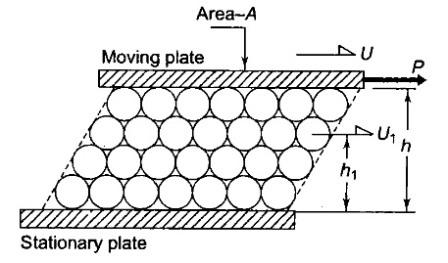
Viscosity:
Viscosity is defined as the internal frictional resistance offered towards the flow by a fluid.
Every fluid has some amount of viscosity
Newton's law of viscosity:
Shear stress is proportional to the rate of shear at any point in the fluid:
Continuous change in velocity w.r.t h is expressed as
The constant of proportionality μ in the above equations is called the absolute or dynamic viscosity
Fig 8: Newton’s law of viscosity

Slide 14
The unit of absolute viscosity is given by
The unit of viscosity in CGS is the Poise (P), which gives absolute viscosity in dyne-s/cm².
Poise being a large unit, cP (Centi Poise) is mostly used.
Viscosity of water is around 1 cP.
The kinematic viscosity is defined as the ratio of absolute viscosity to the density of lubricant. Its unit is m²/s in SI and Stoke (S=cm²/sec) in CGS. Stoke (S) being a large unit cS (centi Stoke) is mostly used.

Slide 15
Viscometry
For laboratory and industrial use there are four types of Viscometers
Rotational Viscometer
Capillary Viscometer
Efflux Viscometer
Falling Sphere Viscometer

Slide 16
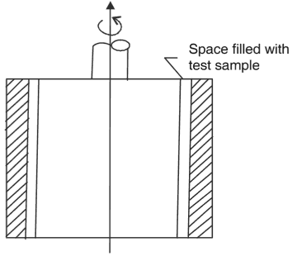
Rotational Viscometer
Only viscometer which measures the absolute viscosity of oil.
Out of two concentric cylinders one rotates in the oil whose viscosity is to be measured.
This apparatus is known as the Couette-Hatscheck Viscometer. When one of the cylinder rotates, the motion of oil between the cylinders is similar to that of flow of liquid between two parallel plates.
However, the effect of curvature can affect the result to some degree.
From the measurement of the frictional drag due to viscous shear on the inner cylinder at a particular velocity it is possible to calculate absolute viscosity.
This instrument is usually calibrated with fluids of known viscosity and the viscosities of test samples are taken from the calibration chart.
Fig. 9: Rotational Viscometer

Slide 17
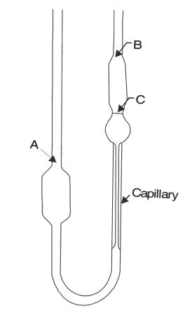
Capillary Viscometer
Due to Hagen Poissoulie
Kinematic viscosity is measured.
The kinematic viscosity is a function of time required for a given volume of liquid to flow through the tube.
The test oil is allowed to flow through a capillary tube of known dimensions.
We have
By using some liquid of known viscosity and density, like distilled water, sugar solution, the time required for a given volume to flow through the capillary is determined and the constant for the instrument is found.
Fig. 10: Capillary Viscometer

Slide 18
Efflux Viscometer
The popular method of determining viscosity is to measure the time required for a given volume of oil to pass through an orifice (or jet).
The oil is kept in a reservoir, which is immersed in the constant temperature bath.
Based on this principle, there are three standard viscometers of efflux type:
Saybolt universal viscometer (USA)
Redwood viscometer (UK)
Engler viscometer (Europe)
Since all these three are alike, only Saybolt Universal Viscometer is discussed here.

Slide 19
Saybolt Viscometer
In the Saybolt universal viscometer, 60 cm³ of lubricating oil is passed through a capillary tube of standard dimensions and the time is measured in seconds.
The unit of viscosity is called Saybolt Universal Seconds (SUS), which is related to kinematic viscosity by the following relationship:
where ‘t’ is viscosity in Saybolt Universal Seconds (SUS) and is kinematic viscosity in centi Stoke (cS)
A similar principle is used in Redwood viscometer and the time is measured in terms of Redwood seconds.
In the Engler viscometer, the viscosity is measured in terms of Engler degrees (°E), which is the ratio of time taken by the oil to the time taken by water at the same temperature.

Slide 20
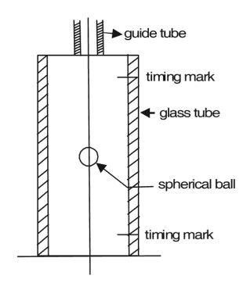
Falling Sphere Viscometer
If a sphere is falling through a viscous liquid under a constant force, it will assume a constant velocity.
Stokes formula can be applied for a sphere moving through an infinite fluid.
A sphere falling freely under gravity in liquid will be attaining a velocity v given by
where R is the radius of the sphere
and are the densities of the sphere material and
liquid
Fig. 11: Falling sphere Viscometer

Slide 21
Viscosity Index (VI)
The viscous resistance of lubricating oil is due to intermolecular forces.
As the temperature increases, the oil expands and the molecules move further apart, decreasing the intermolecular force in consequence.
Therefore, the viscosity of the lubricating oil decreases with increasing temperature.
The approximate relationship between viscosity and absolute temperature is as follows:
where A and B are constants and T is the absolute temperature.

Slide 22
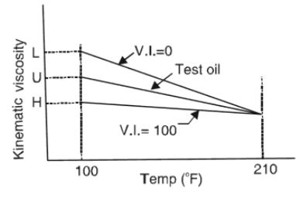
In order to show the effect of temperature change on the viscosity of oil, a viscosity index (V.I.) is used.
To find the viscosity index of an oil, its temperature-viscosity relationship must be compared with two standard oils (Fig.
The viscosity index is given by
where,
= Viscosity at F of the oil whose viscosity
Index is to be calculated.
= Viscosity at F of an oil at 0 V.I. having
the same viscosity at F as the oil whose
viscosity Index is to be calculated
= viscosity at F of an oil of 100 V.I.
Pennsylvania Oil is considered to be superior with VI 100
Gulf Coast Oil is rated as VI 0.
Fig 12: Viscosity Index

